Slide 1
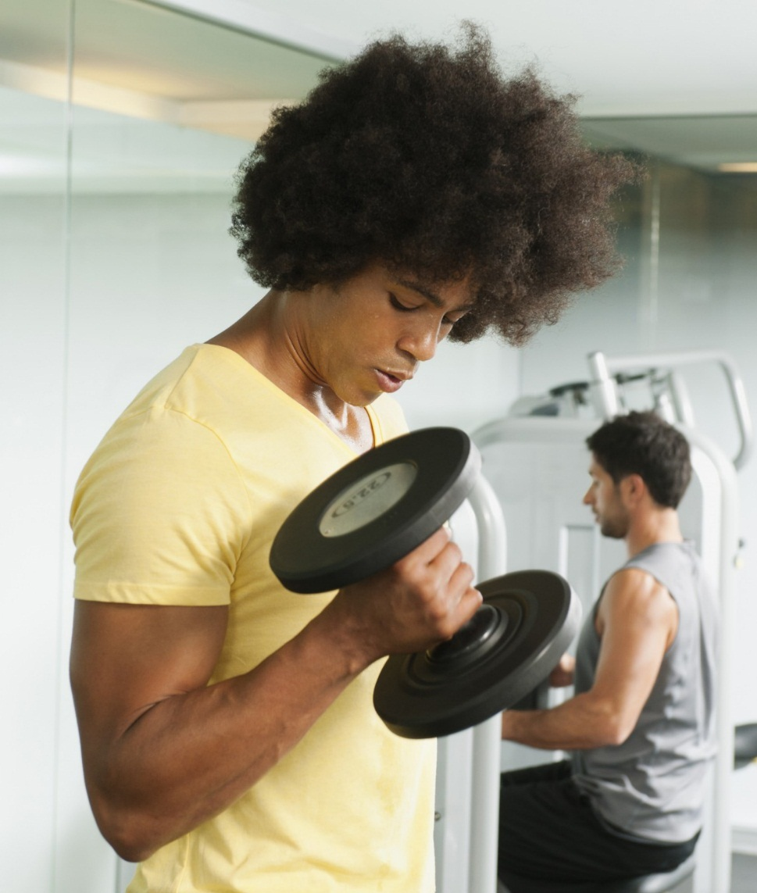
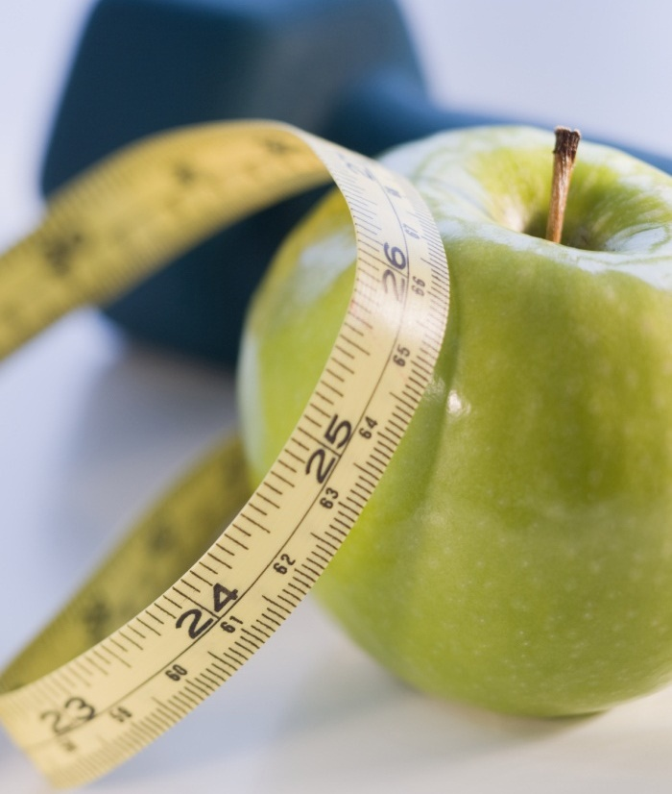

Calculate bmi
We need you to be healthy

Slide 2
This app will calculate BMI and tell you what to do ..
Under Weight
Normal
Over Weight
Over Weight
Normal
Under Weight

Slide 3
We will calculate Bmi depend on some variables
We need the height of the user
We also need the weight
We also need the age
At last we need the gender
The low we use to calculate bmi is : (weight / pow(height / 100, 2))

Slide 4
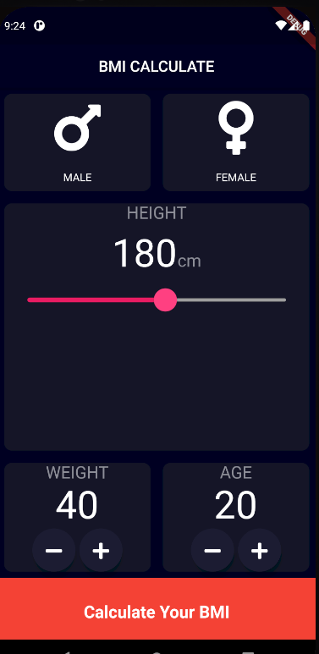
Main Screen
We use flutter widgets to build the UI

Slide 5
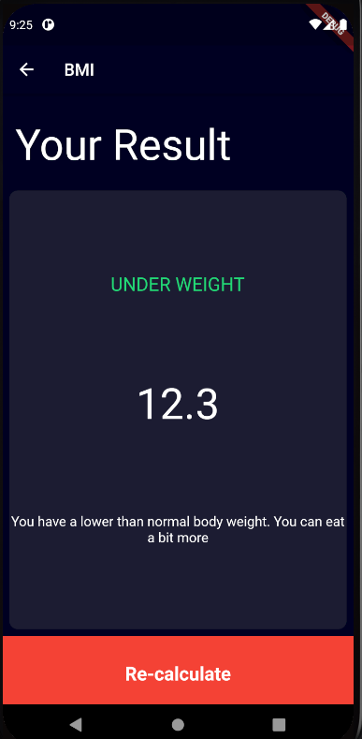
Calculate Screen

Slide 6
Conditions to tell the user The result
if (BMI >= 25) {
return "Over Weight";
} else if (BMI > 18.5) {
return 'NORMAL';
} else {
return 'Under Weight';
}

Slide 7
Conditions to tell the user what to do
if (BMI >= 25) {
return 'you have a higher than normal body weight. try to exercise more.';
} else if BMI > 18.5) {
return 'you have a normal body weight. Good Job';
} else {
return 'You have a lower than normal body weight. You can eat a bit more';
}

Slide 8
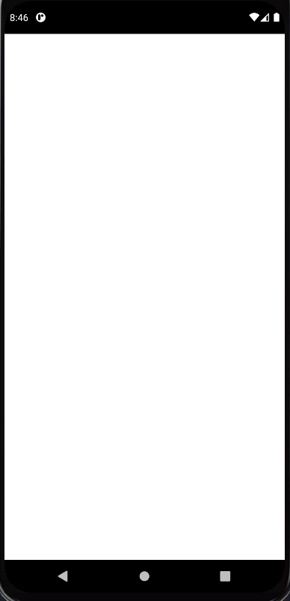
Video to show the full description about the application

